Slide 1

A Flagship Program of MHRD
उन्नत भारत अभियान
शिक्षित भारत- सक्षम भारत- स्वस्थ भारत- स्वावलंबी भारत–संपन्न भारत
समावेशी ग्रामीण विकास के लिए उच्च शिक्षण संस्थाओं के ज्ञान, स्वैच्छिक संगठनो के अनुभव और सरकार के संसाधन, के अभिसरण के हेतु मानव संसाधन मंत्रालय की पहल
Unnat Bharat Abhiyan is inspired by the vision of transformational change in rural development processes by leveraging knowledge institutions to help build the architecture of an Inclusive India.

Slide 2

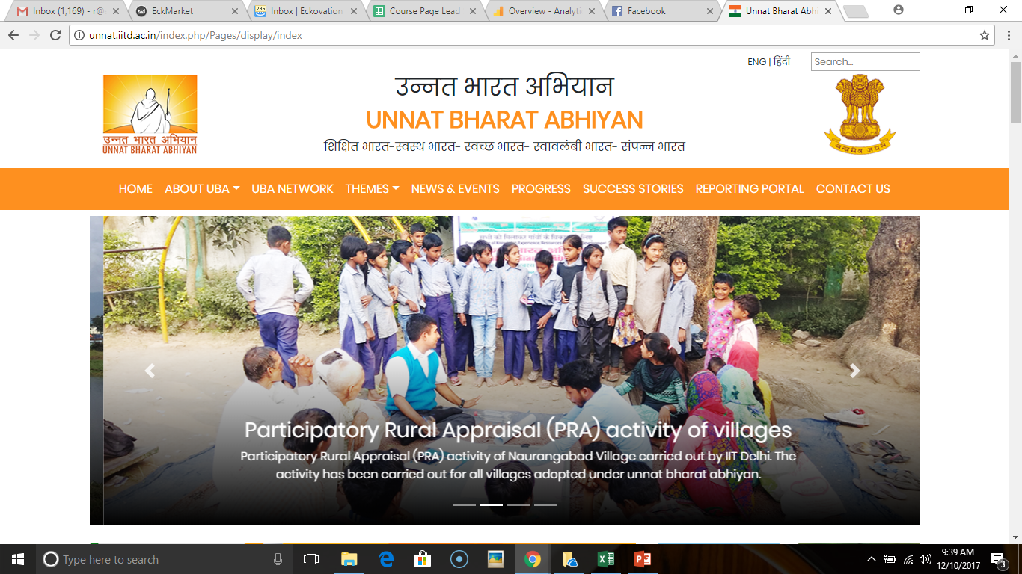
Introduction of Unnat Bharat Abhiyan
Prof. Priyanka Kaushal
Coordinator
National Coordinating Institute
IIT Delhi

Slide 3
Vision
To involve the reputed higher educational institutions (technical / non-technical / public / private) of the country in the process of indigenous development of self-sufficient and sustainable village clusters.

Slide 4

Mission
Coordination among educational institutions, implementation agencies and the grass root level stakeholders
Effective participation in the holistic development of rural clusters using
Eco-friendly sustainable technologies
Harnessing Local resources
Creating employment opportunities
Harnessing multifarious government schemes
Customisation of existing technologies
Use of local knowledge
Reorienting the academic curriculum and research programs in higher educational institutions

Slide 5
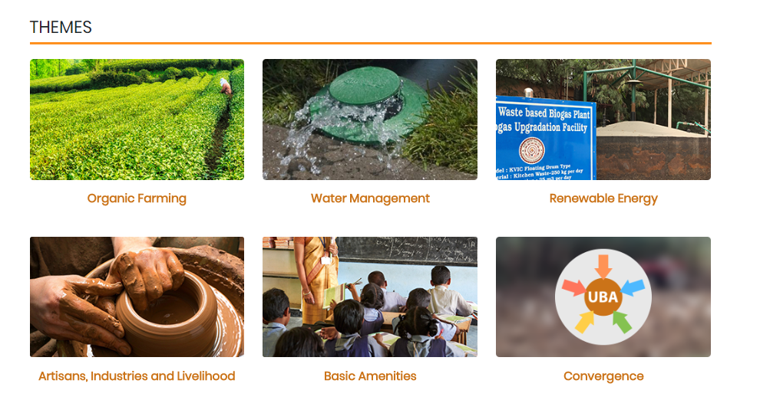

Slide 6
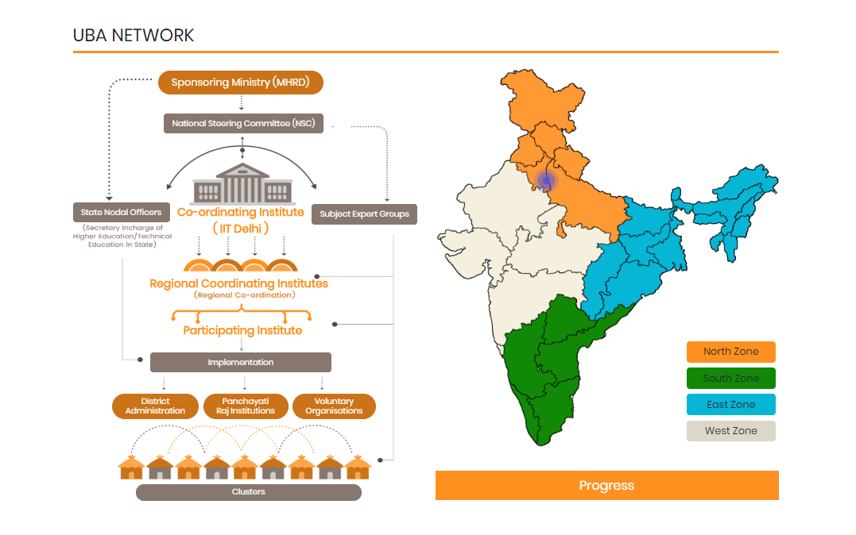

Slide 7

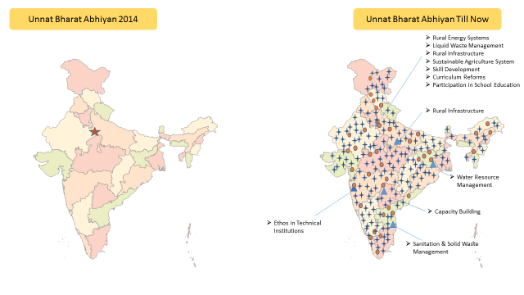
UBA Network
1 NCI
45 RCI
13 SEG
2614 PIs
Covering All States with 65 Aspirational Districts(228 PI working in those)

Slide 8
UBA Summary
Item | Unnat Bharat Abhiyan Challenge mode (April 2016 – Till now)
National Coordinating Institute | IIT Delhi
Regional Coordinating Institutes | 45 in all over the country (covered all 29 States and 7 UTIs)
Subject Expert Group | 13
Orientation workshop | 40 workshops at Regional coordinating Institutes level and 8 through virtual channels
No. of PIs attended the Orientation workshop | ~1800
No of PIs under Unnat Bharat Abhiyan | 2614
No of villages adopted under UBA | ~14000
State and districts covered | 432 districts through 29 States and 6 UTIs
Aspirational District Covered | 58 Aspirational Districts through 172 Participating Institutes
Districts covered through technology intervention and customisation | 47 districts through 18 states
Technical intervention at field level | ~117
Village and Household Level Survey | 4650 village and 475702 Households

Slide 9
Framework of Action Plan For Participating Institutions

Slide 10
To Suggest Steps/Guidelines to the PIs for formulating plan of action for Village Development
Objective
Selection of Village
Awareness and Participation
Planning
Project Formulation
Implementation
Monitoring and Assessment
Evaluation
Strategy

Slide 11
Selection of the Village
Closeness to the institute
Backwardness of Village
Any Prior linkage of institute

Slide 12
Establishing Contact, Awareness and Participation
Meeting with Panchayat Secretary, Gram Pradhan, BDPO, JE
Meeting with elders, youth groups, Women groups
Identifying one problem and provide immediate solution

Slide 13
Awareness and Participation
Engage the faculty members
NSS and Student volunteers
Student Clubs (film society, dramatics, fine arts, etc.)
Field Agencies and Organizations
Institutes in the neighbourhood

Slide 14
Planning Perspective
Surveys
Situation Analysis
Need Analysis
Comprehensive Development Plan
Plan of Action-Implementable Projects
Transect Walk
PRA
Gram Sabha

Slide 15
Situation Analysis and Need Identification
Baseline Survey
Identification of Key Issues
Participatory Planning
People’s priority
Local Solutions
Selection of interventions

Slide 16
Analysis through Baseline Survey
DEMOGRAPHIC PROFILE
Gender
Age Group
Poverty
Linking with Govt Schemes
BASIC AMENITIES
Education
Health
Drinking Water
Drainage and Sanitation
SLWM
LAND AND AGRICULTURE RESOURCES
Land use pattern
Irrigation
Forest and Horticulture
Use of Chemicals
Livestock status
ENERGY AND POWER
Lighting source
Cooking Fuel

Slide 17
Project Formulation
Technology identification and Proposing Solution
Validation through experts-SEG
Cost Estimation
Identification of schemes
People’s Feedback
Discussion with District Agencies
Funding and Convergence
Implementation of the Solutions

Slide 18
Monitoring, Assessment and Evaluation
Setting up of Measurable Targets
Documentation of all the experiences
Periodic Assessment of set targets

Slide 19
Tentative time line
Item of Work | Time From Selection of Villages (In Months)
Selection of the cluster | -
Awareness generation | Two
Social mobilisation | Two
Baseline survey | Two
Situation analysis | Two-Four
Action Plan (Project Formulation, mapping with schemes, departments) | Three-Seven
Approval and sanctions | Four-Eight
Implementation in the field | After Five Months
Progress review | one

Slide 20
National Level Monitoring
Web based system
Every activity to be documented and made available in public domain
The outputs under each activity would be measured every quarter in relation to the physical and financial targets

Slide 21
Funding Possibilities
UBA funds
Institutional Support
Attracting Alumni
Society Participation
Stakeholder’s Contribution
CSR funds and Special Projects
Government programs through District Authorities
Central Government schemes
State Government schemes
Convergence
Institutions-PRIs-Voluntary Organizations-Government Agencies
Flagship programs of Central and State Governments

Slide 22
UBA funds
Funds for Awareness, survey, visits etc @Rs. 10000.00 per village
Technology Development Rs. 1.0 lakh per technology
Customization of solution Rs. 50000.00 per solution
Future Possibilities in Pipeline
Perennial Assistance funds for multiple developmental work Rs. 1.75 lakhs to selected PIs
Incentivizing Appreciation funds 10% of the generated funds

Slide 23
Subject Expert Group

Slide 24
Rural Energy Systems
Rural Craft and Artisans Development & Rural Industrialization and Entrepreneurship Development
Sanitation & Solid Waste Management
Liquid Waste Management
Rural Infrastructure
Ethos in Technical Institutions
Water Resource Management
Sustainable Agriculture System
Capacity Building ,Strategy for Convergence and Implementation of Various Govt. Schemes
Curriculum Reforms and Educational Institutions Social Responsibility
Participation in School Education
Others and COVID-19

Slide 25
S.N. | SEG Name | Institute | Coordinator
1 | Rural Energy Systems | IIT Delhi | Prof. Ramchandra
2 | Rural Craft and Artisans Development & Rural Industrialization and Entrepreneurship Development | IIT Kanpur | Dr. Koumudi Patil
3 | Sanitation & Solid Waste Management | IIT Madras | Prof. Devendra Jalihal
4 | Liquid Waste Management | IIT Delhi | Prof. Vivek Kumar
5 | Rural Infrastructure | NIT Delhi | Prof. Praveen Kumar
6 | Ethos in Technical Institutions | IIT Mumbai | Prof. Millind Sohoni
7 | Water Resource Management | IIT Kharagpur & GSIT Indore | Dr. Brajesh Kumar Dubey & Dr. Milind Dandekar
8 | Sustainable Agriculture System | IARI New Delhi | Dr. J P Sharma & Members-Prof. Hari Prasad, Prof. JK Sahu
9 | Capacity Building ,Strategy for Convergence and Implementation of Various Govt. Schemes | NIRD&PR, Hyderabad | Dr. Gyanmudra
10 | Curriculum Reforms and Educational Institutions Social Responsibility | UGC | Dr. Renu Batra
11 | Participation in School Education | IIT Delhi | Prof. Nomesh Bolia
12 | Others and COVID-19 | IIT Delhi | Prof. Priyanka Kaushaul

Slide 26
The Subject Expert Groups (13 SEGs) are institutions which have been appointed by the NCI for providing operational expertise sought by the institutions engaged in the rural works.
Role of Subject Expert Groups(SEGs) :
To act as think tank and technical expertise resource.
To provide guidance on the vision, strategies and tentative roadmap in the subject area.
To provide technology compendium in their Subject Expert area.
To evaluate and approve new technical solutions submitted by PIs or any other inventors.

Slide 27
Technical Proposal comes under
Technology Customisation
Technology Development

Slide 28
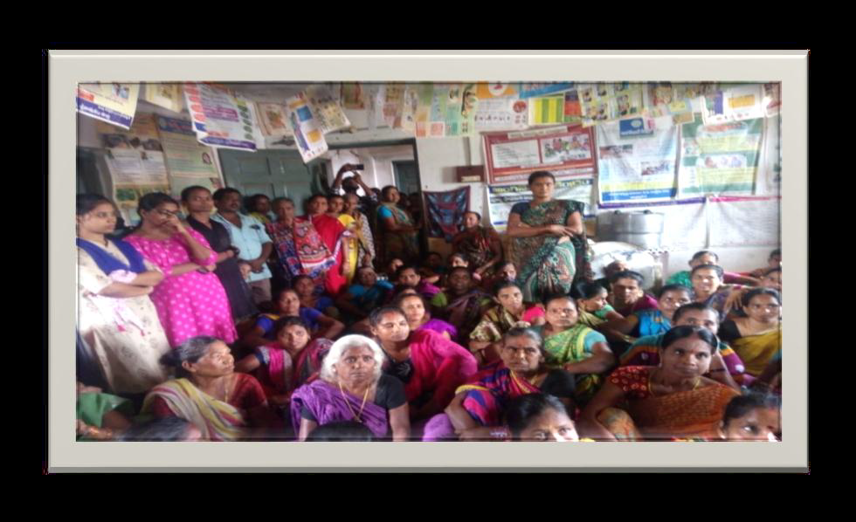
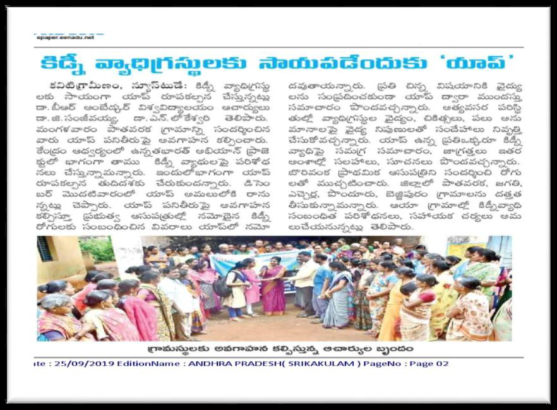
Name of the institute & code | Dr. B. R. Ambedkhar University Srikakulam, Andhra Pradesh, India. Code: U – 0009
Title of the project | “Provision of Better Health Condition facilities through a Mobile App for Kidney patients in Pathavaraka villege, Uddanam region”
Name of Subject expert group | Health and Sanitation
Name of villages where project development | PathavarakaVillage, Kaviti Mandal, Uddanam Region, Srikakulam
Duration/ Budget of the project | One year/ 1,00000 (One Lakh)

Slide 29
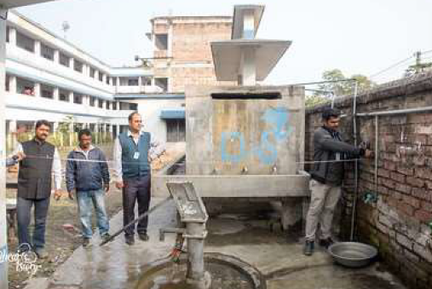
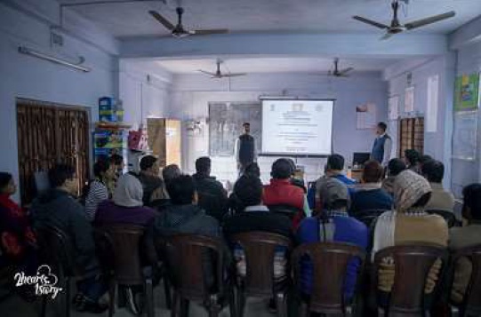
Name of the institute & AISHE code | Brainware University U-0846
Title of the project | Rainwater Harvesting Technology
Name of Subject expert group | Water Resource Management
Name of villages where project development activities | Faldi (Faldi High School)
Budget of the project | 0.50 lakh

Slide 30

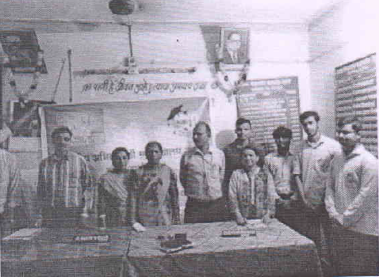
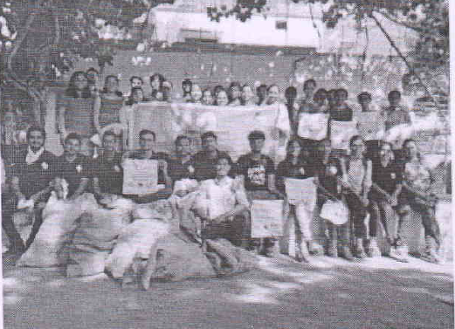
Name of the institute & code | Government College of Engineering, Nagpur , Institute Code: C-56586
Title of the project | Smart Compost Bin(A smart compost bin is a plastic bin of capacity 2000 litres. It is double wall insulated with polystyrene against cold weather, It has a base with a reservoir to collect its own liquid organic fertilizer)
Name of Subject expert group | Basic Amenities
Name of villages where project envelopment | Khapri
Duration /Budget of the project | 12 Months/ I Lakh

Slide 31
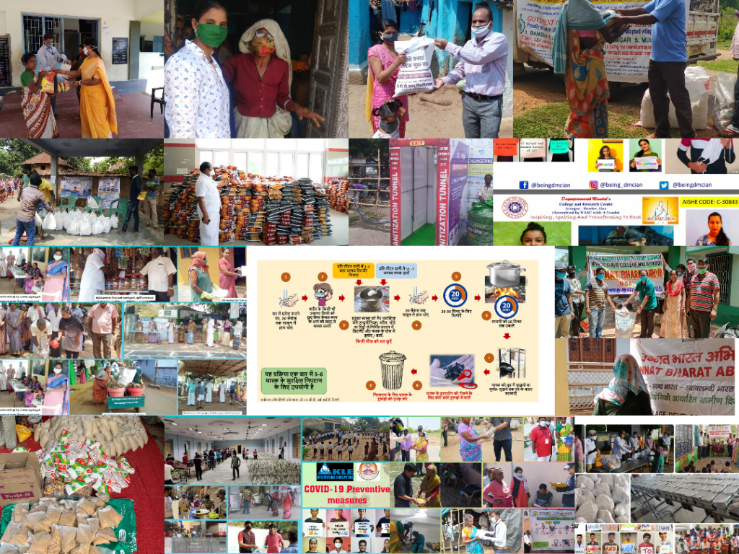

Slide 32
Thank You

